Slide 1
Anita - Darknet
27-09-2019

Slide 2
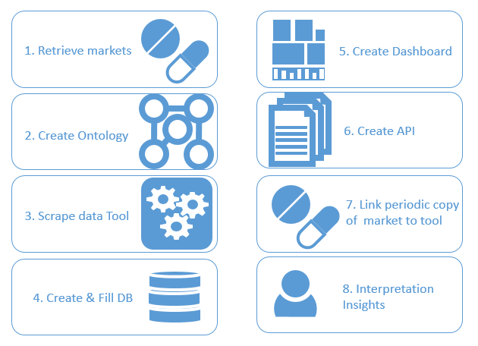

Slide 3
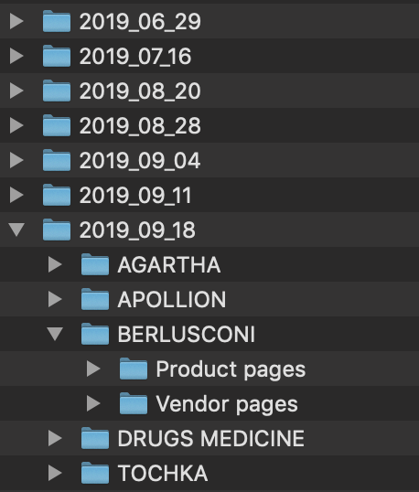
1. Retrieve Markets (Data)
Focus on drugs
HTML files
Tried to retain URL information

Slide 4
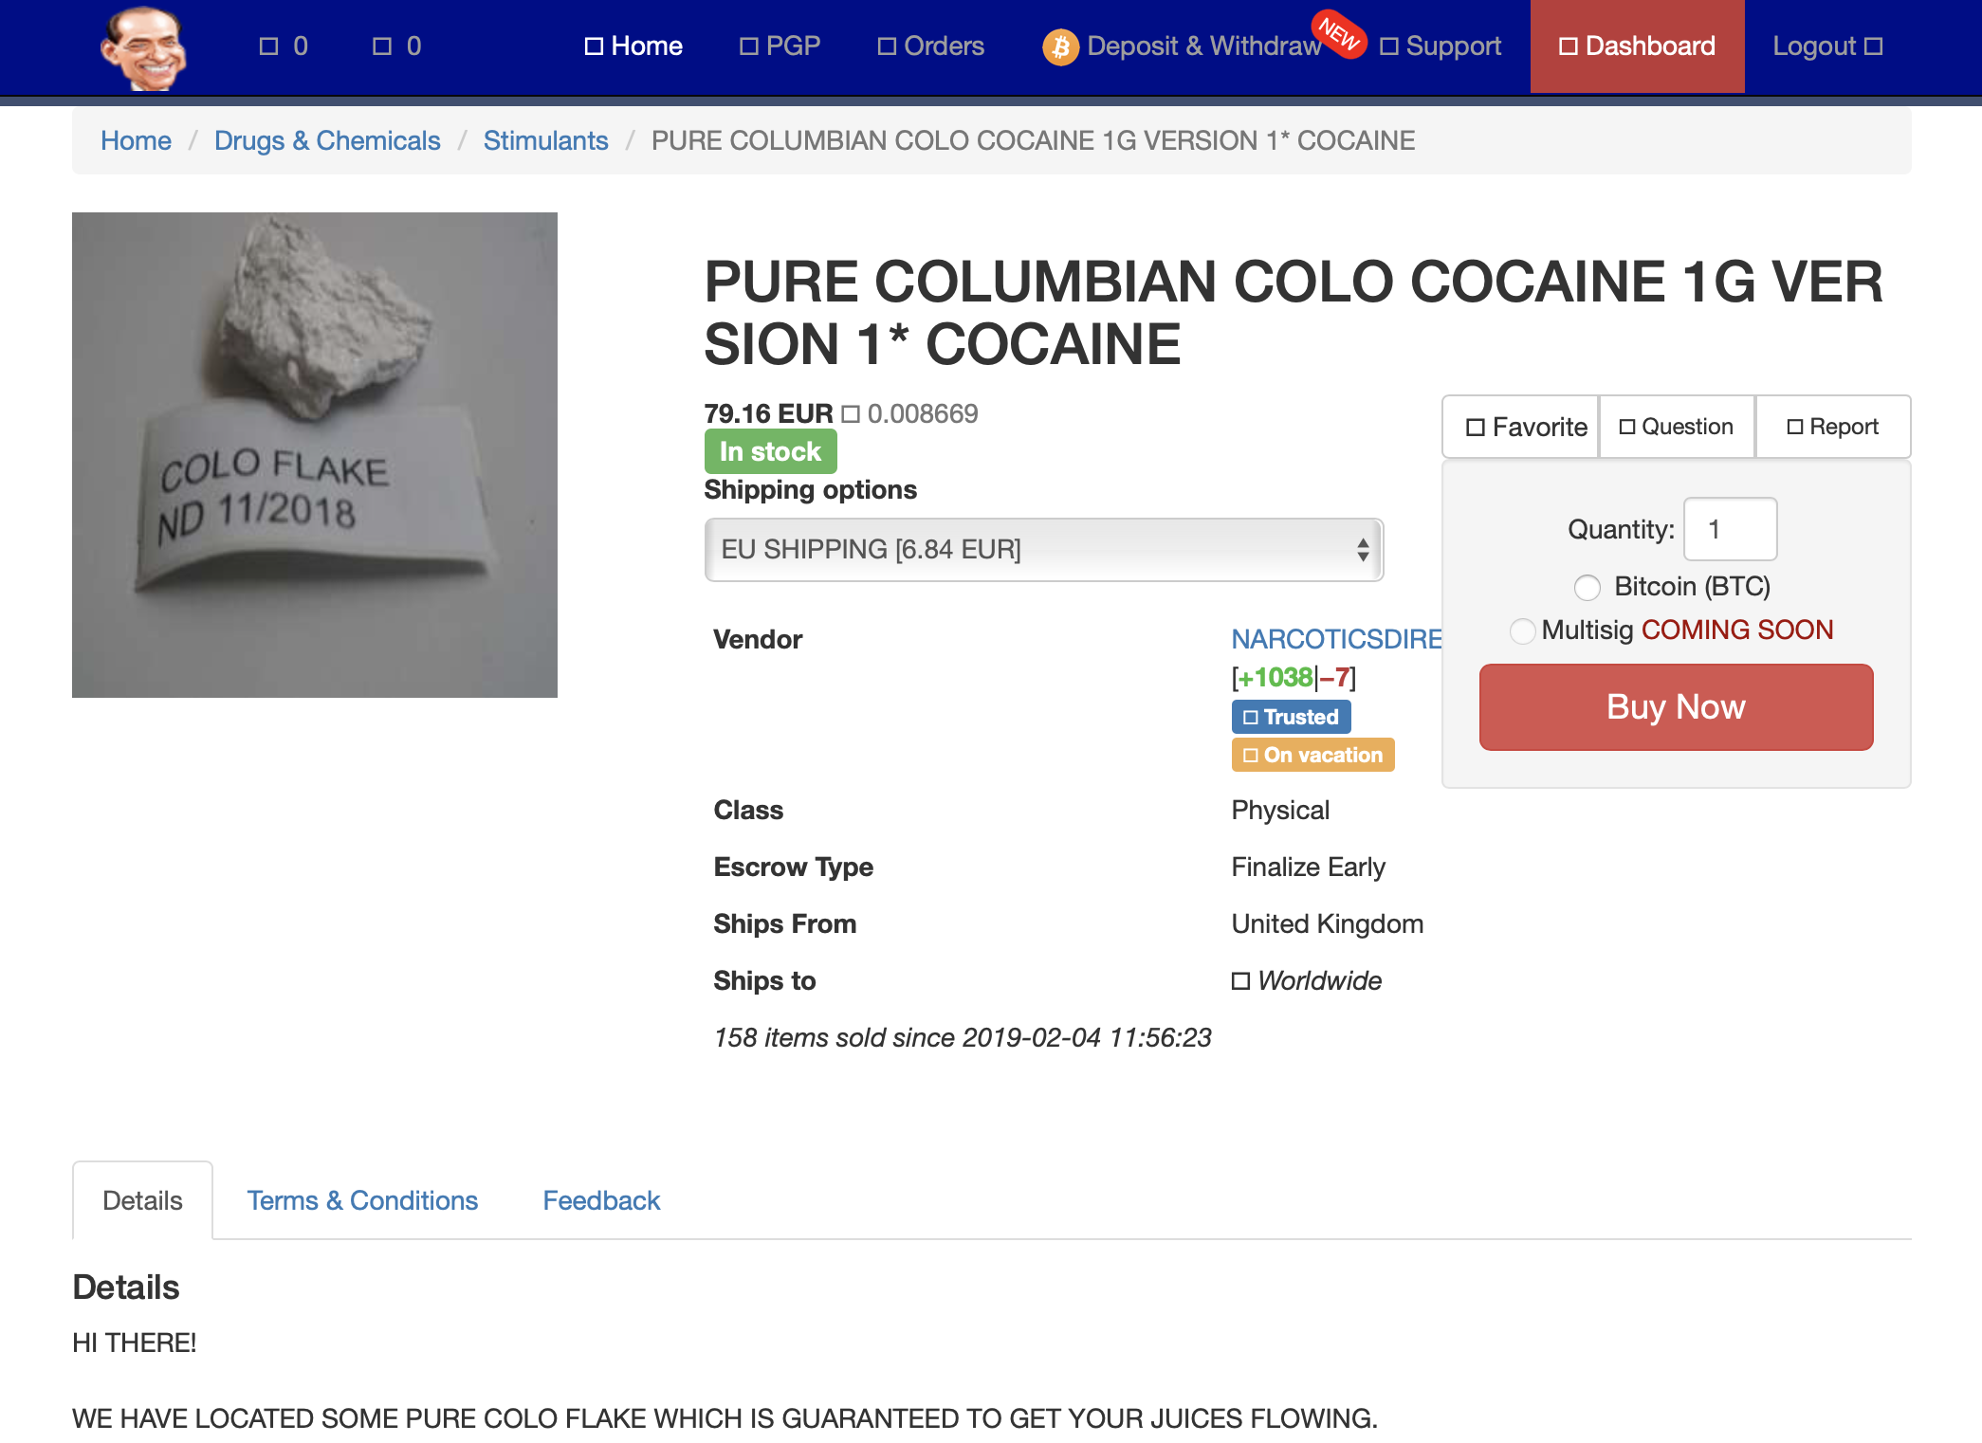

Slide 5
1. Retrieve Markets (Data)
To do:
Retrieve more data

Slide 6
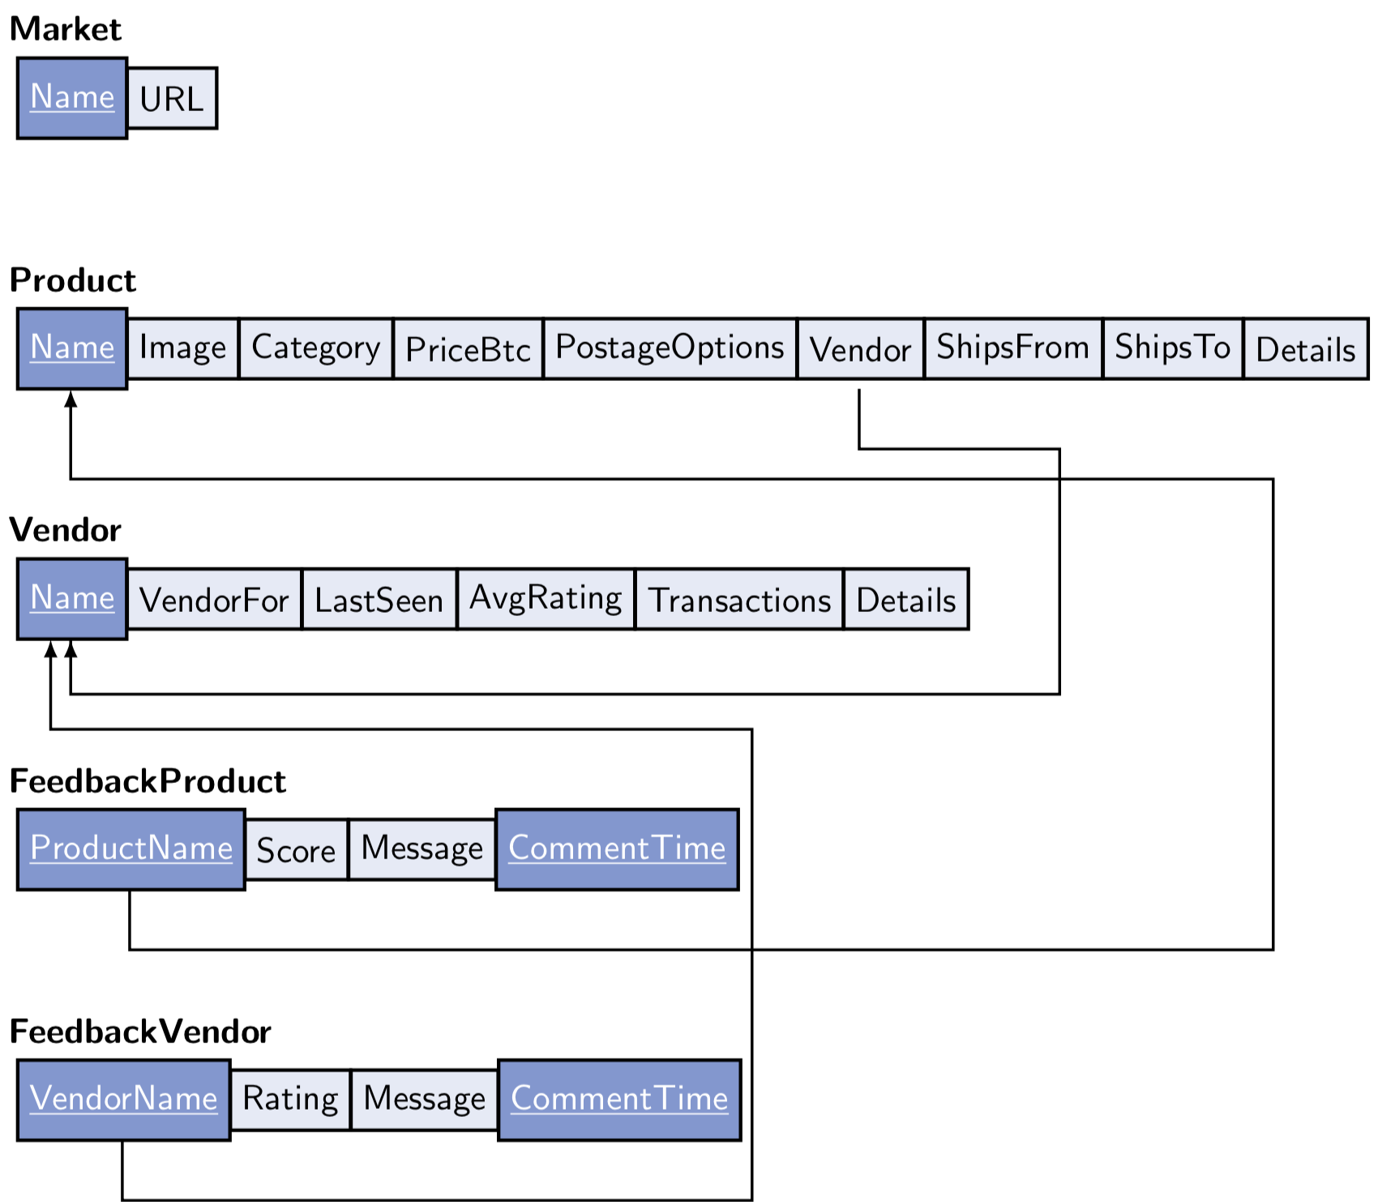
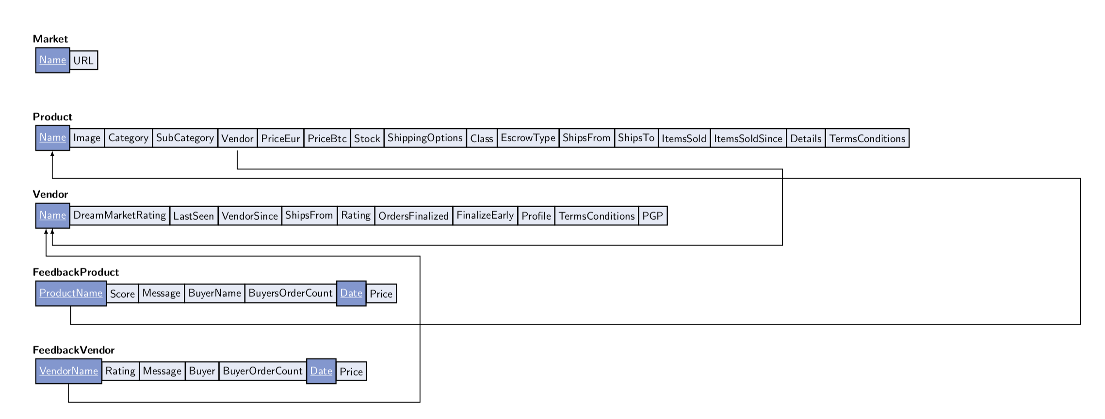
2. Create Ontology

Slide 7
2. Create Ontology

Slide 8
2. Create ontology
To do:
Create models for Tochka
Combine information from models to build 1 Umbrella model (for comparing data between markets)
Create Codebook to explain labels / transformations etc.

Slide 9
3. Build scaper
Build scrapers (based on the html files for now)

Slide 12
3. Scraper
To do:
Add some functionalities to Berlusconi scraper
Create scraper for:
Agartha
Appolion
Tochka

Slide 13
4. Create & Fill DB
Just a pandas DF right now
HTML files
JSON
PANDAS
General information
Retaining all information

Slide 14
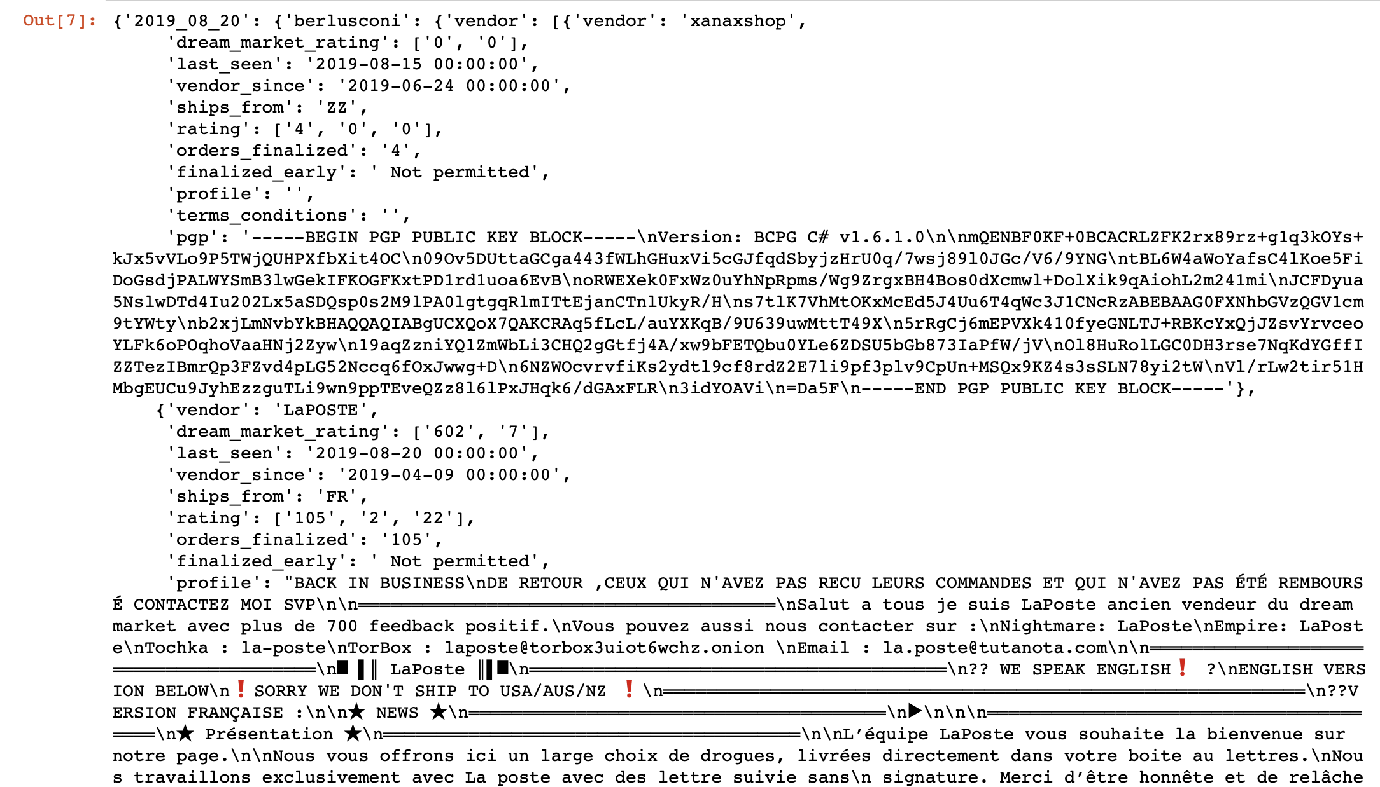

Slide 15
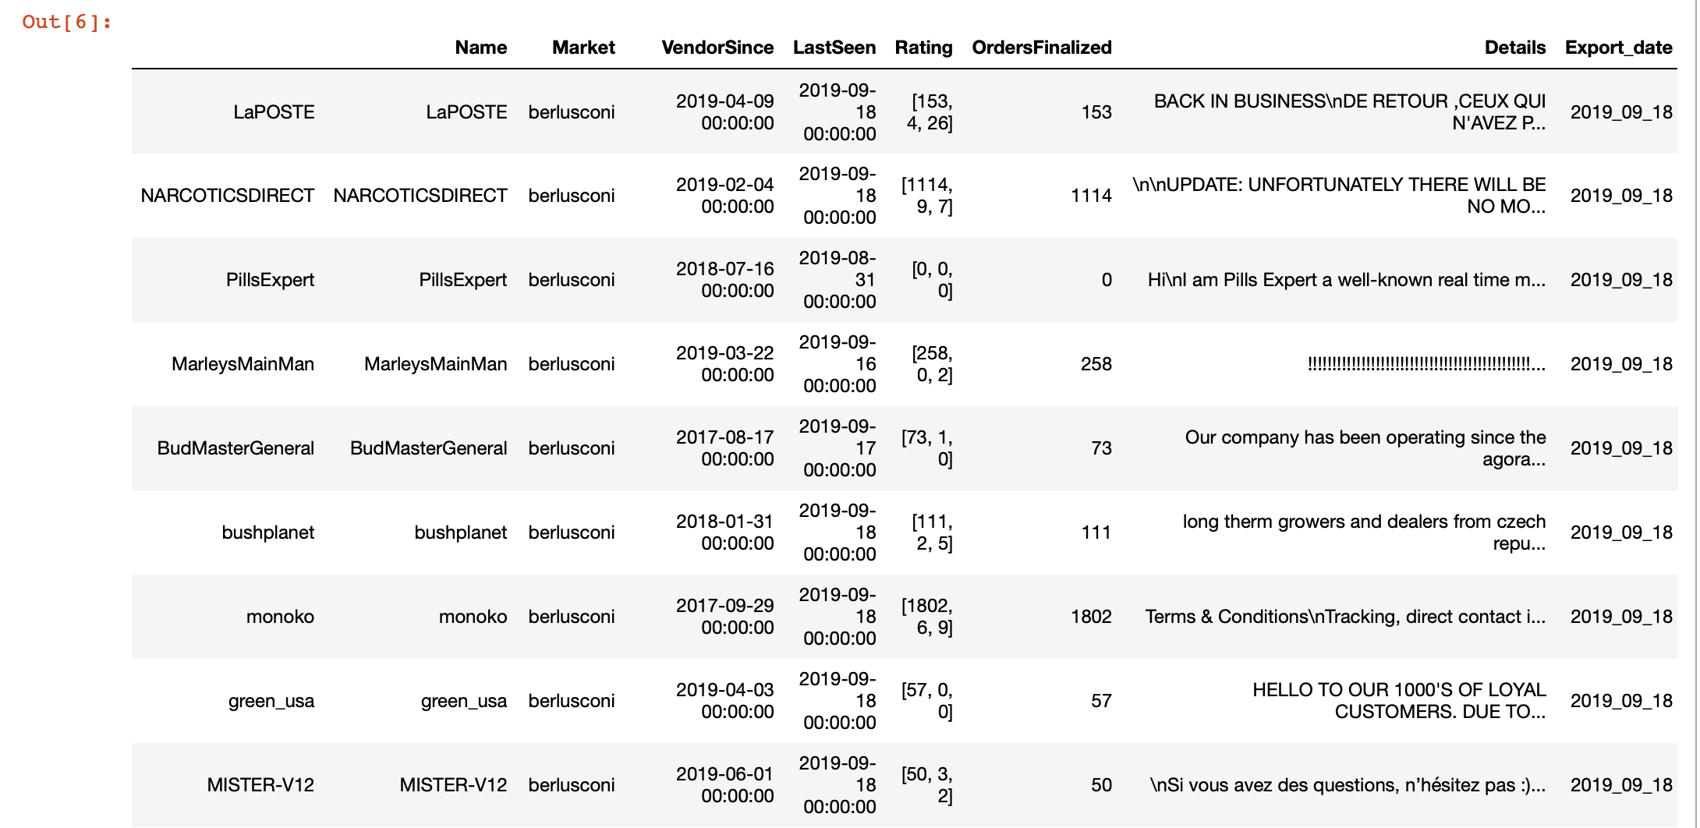

Slide 16
4. Create & Fill DB
To do (A LOT), few things:
Create DF for reviews, removing duplicates (vendor & products)
Standardize:
(sub) category
Score
ShippingFrom
ShippingTo
Extract PGP

Slide 17
5. Create Dashboard
Created something to create an idea what’s possible.
http://127.0.0.1:8050

Slide 18
5. Create Dashboard
Ideas:
Give a overview of total(s) and plot the trends
Total market
Total per category (see which drugs are more sold when etc.)
Look for cross-platform vendors using PGP and combine information
Search the surface web for images / PGP?
Get some signature out of the text? (no idea how)
Etc. etc.

